Slide 1

ADVENTURE WORKS PROJECT
Business Intelligence Report

Slide 2
Agenda
Objective
Approach
Requirement Analysis and Questionnaire
Data Validation
Data Modelling
Power Bi Project and Objects
Report Creation
Data testing
Issues Faced & Lessons Learnt

Slide 3
Objective
01

Slide 4
Objective
The Company Adventure Works is a Bicycle manufacturer – Adventure Works Cycles.
Sales Analysis Report Presentation Objective
Objective: Deliver a comprehensive Sales Analysis Report covering the years 2014, 2015, and 2016.
Key Analyses:
Yearly Sales Comparison: Compare sales performance over three years to identify trends.
Monthly Sales Trend by Region: Analyze regional sales patterns and opportunities on a monthly basis.
Category, Subcategory-Based Sales, and Top Customers: Identify best-performing products and customer segments.
Drill-Through Analysis: Explore individual product sales and changes from the previous year.
Additional Dashboard:
Profit Analysis: Demographic and product-based insights for better decision-making.
Goal: Provide valuable insights for data-driven decisions and strategic planning to boost sales and profitability.

Slide 5
Approach
02

Slide 6
APPROACH
Requirement Analysis &
Questionnaire
Data Validation
Data Loading ,Transform & Modelling
Power BI Objects
Report Creation
Unit testing

Slide 7
Requirement Analysis and Questionnaire
03

Slide 8
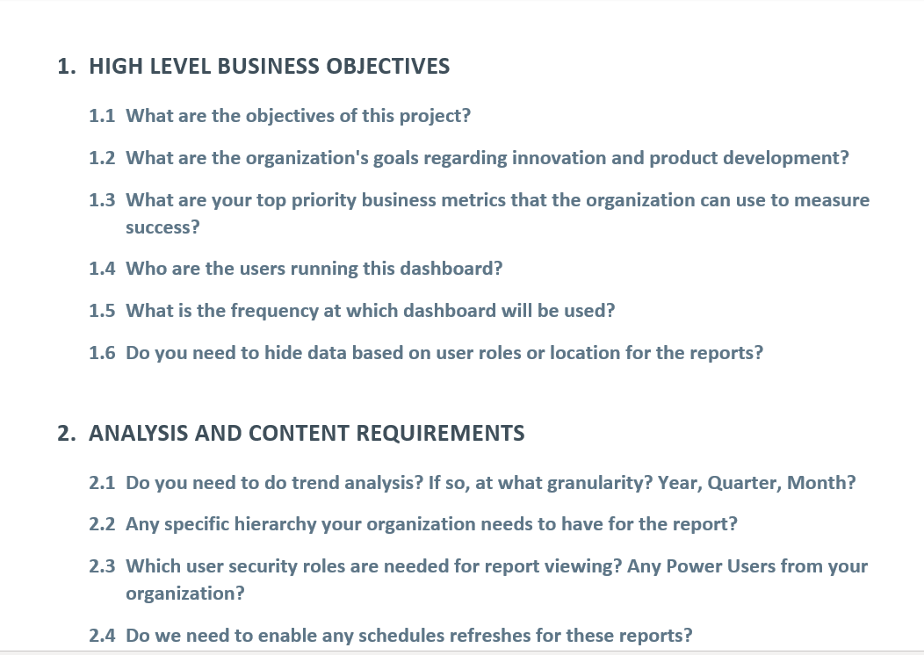
Requirement Analysis and Questionnaire

Slide 9
Data Validation
04

Slide 10
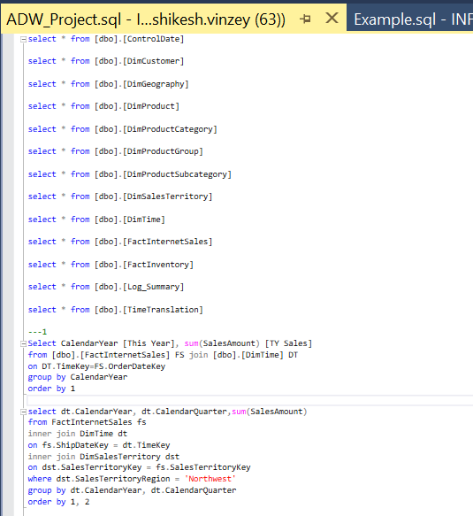
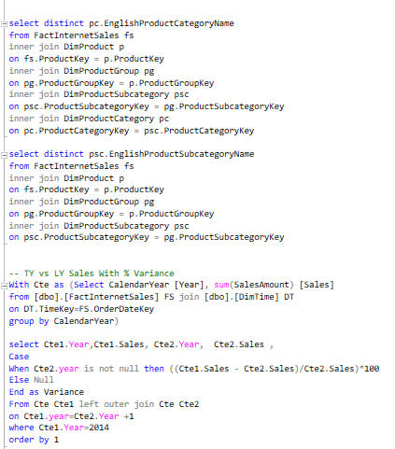
Data Validation
The Data provided is analyzed to verify the scope of requirements made by the client.

Slide 11
Data Modelling
05

Slide 12
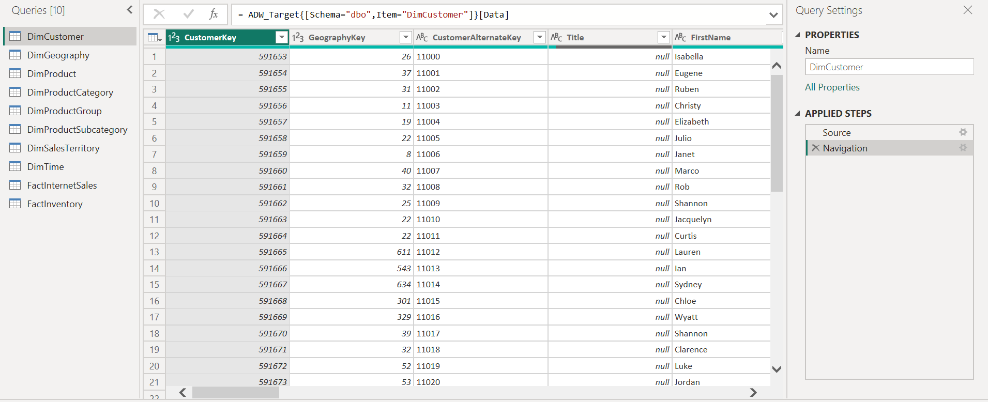
Data Loading & Transformation

Slide 13
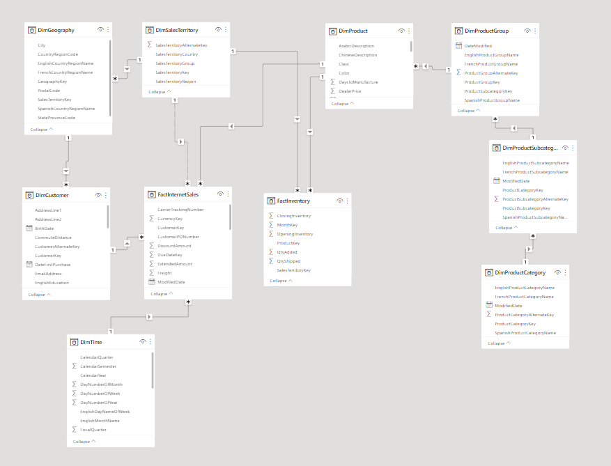
Data Modelling

Slide 14
Power Bi Project and Objects
06

Slide 15
Power Bi Project and Objects
Measures and Calculated Columns are created to support in Project Creation

Slide 16
Report Creation
07

Slide 17
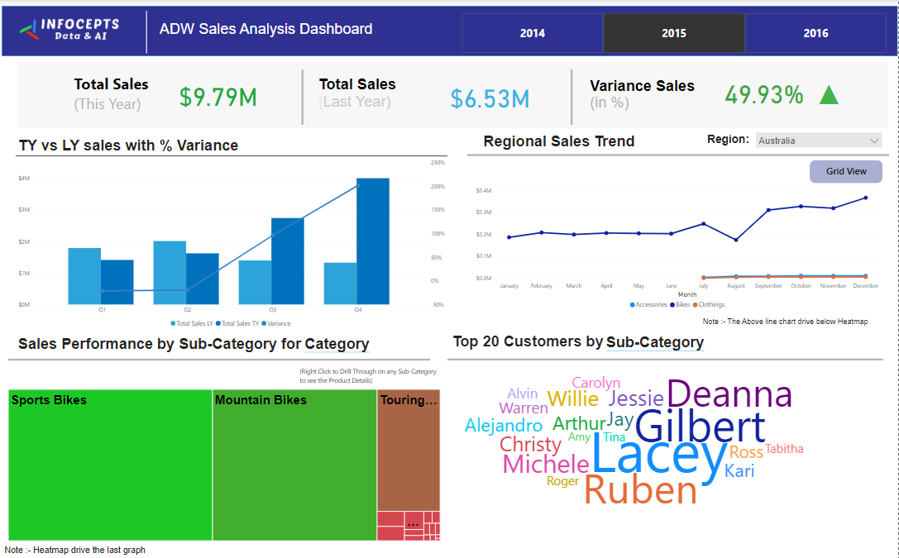

Slide 18
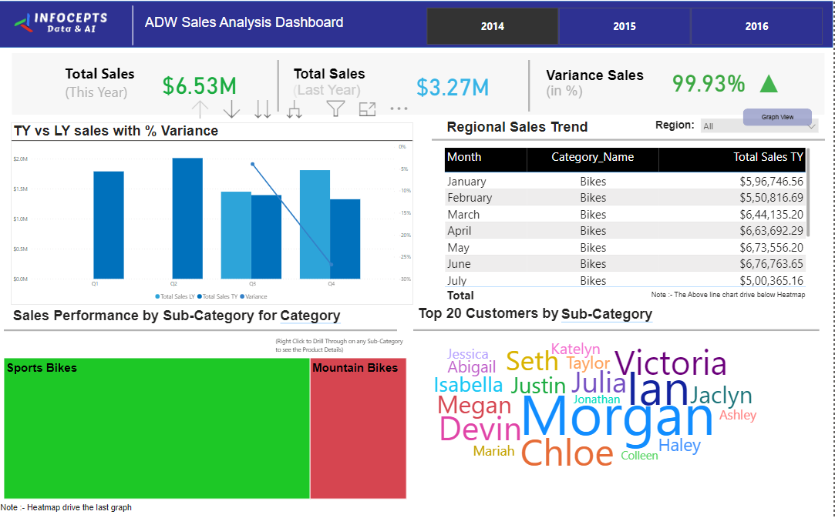

Slide 19
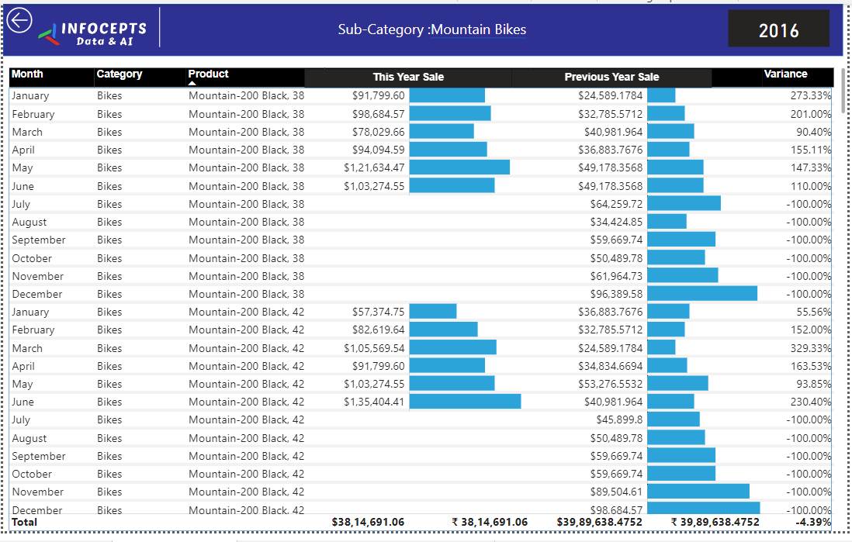

Slide 20
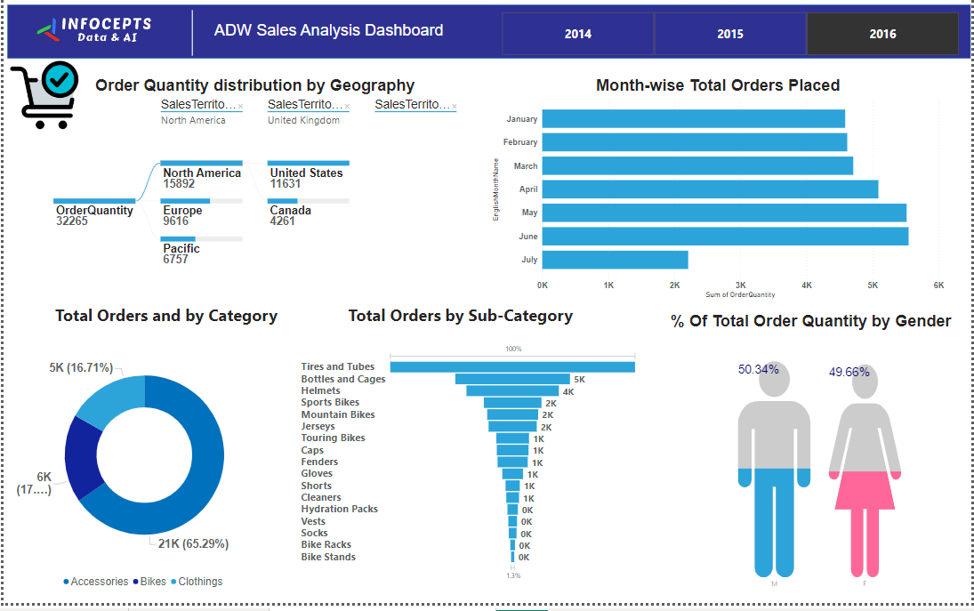

Slide 21
Data testing
08

Slide 22
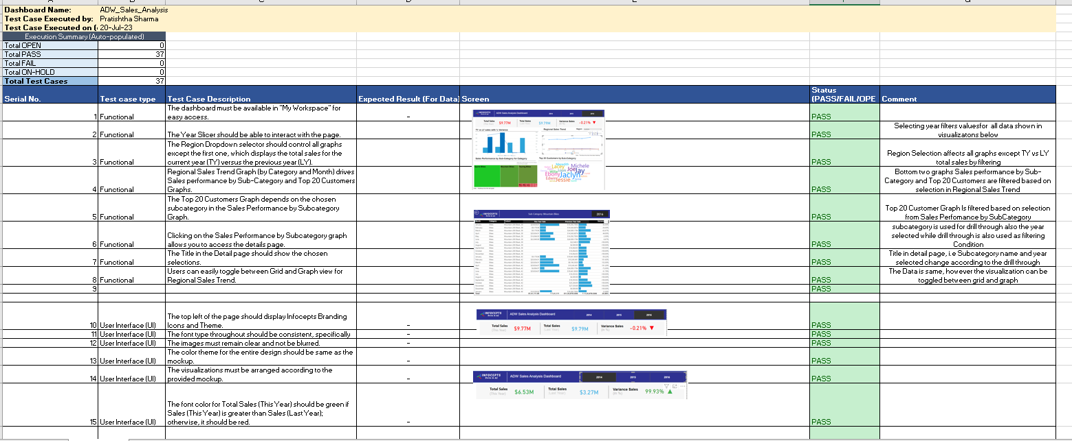
Data testing
Testing Based on Functionality, Interface and Data is executed and documented as shown below
Link for the Document

Slide 23
Issues Faced & Lessons Learnt
09

Slide 24
Issues Faced & Lessons Learnt
Issues Faced
The Top 20 Customer analysis was being done based customer first name
Sales territory were having one active and an inactive relationship resulting in inaccurate data
Lessons Learnt
Using Customer key to base the aggregation in the Visual but not include the field in the display
Creating a duplicate territory table one which joins separately to geography and one with fact sales

Slide 25
Email address:
pratishtha.sharma@infocepts.com
Contact number:
+919602449392

